Slide 2
How to give a drupal camp talk!
Notes:
Title Page

Slide 3


Who am i?
Software developer since 1990 or so.
Drupal developer since 2013.
I work for Breakthrough Technologies.
Love the Drupal community (that’s you!).
Back-end developer. I’ll theme something if I *have* to. (I mean, look at how pretty this slide is!)
Contributor and maintainer for a handful of modules.
Oh, and BTW, Acquia Certified Grand Master!
And my favorite Muppet is Pepé the King Prawn.

Slide 4
What we’ll cover
Don’t be afraid.
Your ideas are valuable.
How to share your excitement about Drupal with the community.
Building your talk.
Practicing.
And actually doing it!

Slide 5
Be excited about something!

Slide 6
Be excited!
We work with cool technology.
We solve problems every day.
Someone else is probably having the same problem you had.
Something you’ve done can help somebody else!
Notes:
The stuff we do is very cool and exciting, and since we’re all nerds here, we all find it cool and exciting.

Slide 7
Don’t be afraid!

Slide 8
Don’t be afraid
You don’t have to know everything.
If you aren’t sure if your idea is good, try it out by giving a lightning talk. You’ll find out whether this is something you want to talk about.
Notes:
Public speaking fear is a real thing, but the easiest way to get over it is to actually do it. It’s not as scary as you think. Most of us who you see up here presenting have at some time been nervous about giving some presentation or talking in front of a big crowd or something. There’s always a challenge – you can get through it. Just believe that you can do it, and you can do it.

Slide 9
Putting your talk together

Slide 10
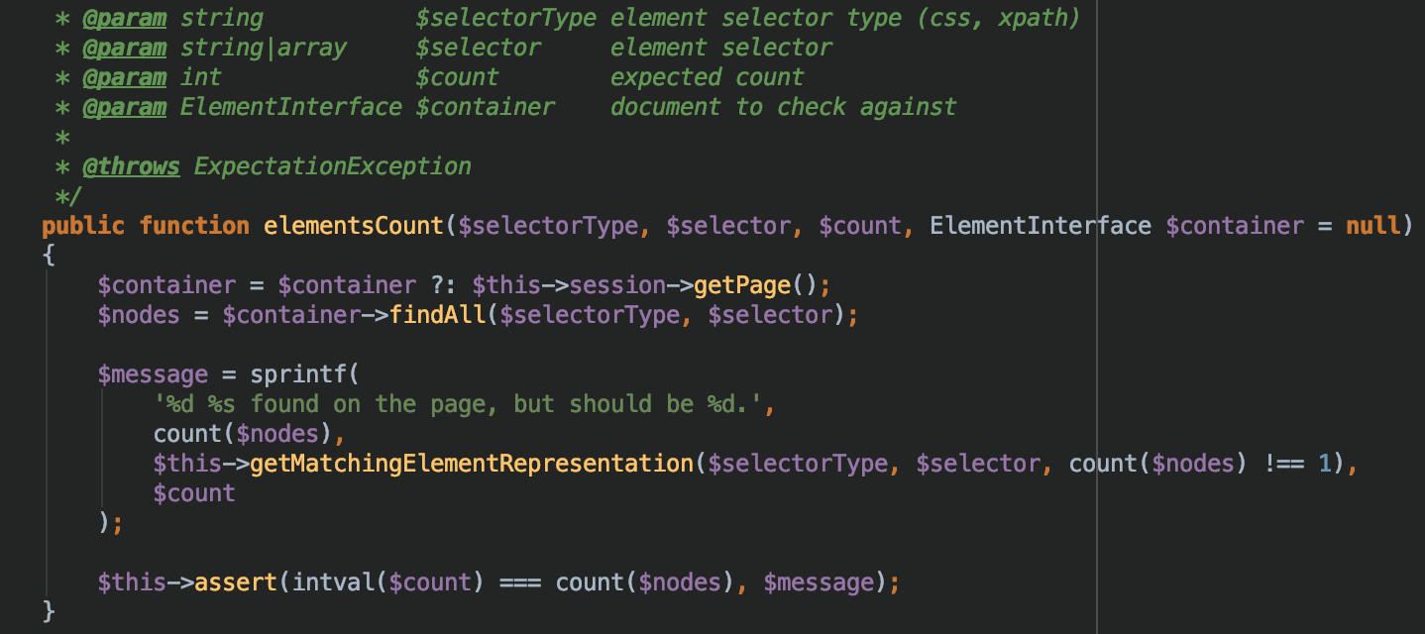
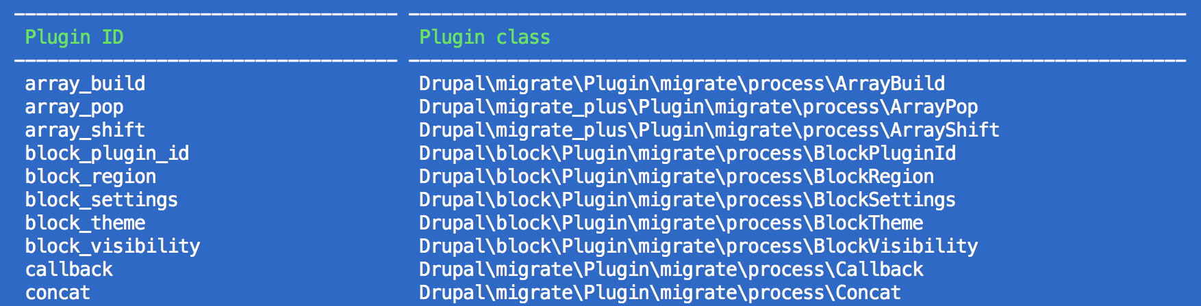
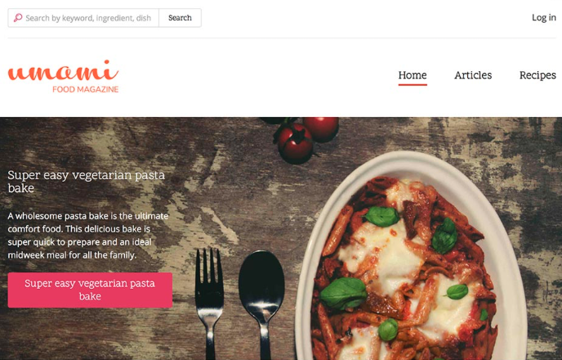
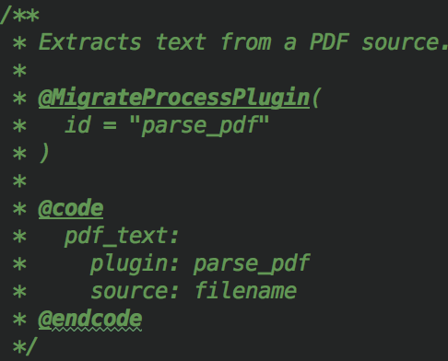
What do you like in a talk?
Now that you’ve picked a topic, it’s time to figure out what your talk is going to look like.
What were some of your favorite sessions?
What did you like about them?
Do you like code?
Do you like walkthroughs?
Do you like live demos?
Notes:
----- Meeting Notes (2/22/18 20:14) -----
Go to the info file in the module already up - midcamp_migrate_pdf.info.yml

Slide 11
Memes

Slide 12
Cat pictures
This is actually the first presentation I’ve put together that’s included a meme or a cat picture, but apparently, everybody loves cat pictures.
I really stick to the techy stuff, but do what works for you.

Slide 13
Prepare

Slide 14
prepare
Do’s:
Practice!
Practice in of real people!
Practice in front of different people!
Record yourself giving your talk.
Practice your demos over and over again.
Listen to your audience’s feedback.
Incrementally improve your talk.
Don’ts:
Don’t put your writing presentation off until the day before the camp!
Don’t put writing code samples off until the day before the camp!
Don’t demo whatever you’re demoing for the first time during your talk!
Don’t read directly off your slides.
Radically change your talk between presentations.
Notes:
----- Meeting Notes (2/22/18 20:14) -----
Go to the info file in the module already up - midcamp_migrate_pdf.info.yml

Slide 15
Practice

Slide 16
Practice
Practice.
Practice some more.
And then practice again.
Then you’re ready for a test run.
By the time camp starts, you’ll be part totally sick of your topic, and part super excited about your talk.
But you’ll be ready!
Notes:
----- Meeting Notes (2/22/18 20:14) -----
Go to the info file in the module already up - midcamp_migrate_pdf.info.yml

Slide 17
Present

Slide 18
present
Slow down.
You’re not giving disclaimers at the end of a radio commercial. You’re trying to impart some valuable information!
You think you’re speaking way faster than you are.
Remember to pause. Let your audience think about what you’ve said and catch up.
Image used from https://www.amazon.com/STOP-Signs-And-More-Slow/dp/B004LDO3DM without permission.
Notes:
----- Meeting Notes (2/22/18 20:14) -----
Go to the info file in the module already up - midcamp_migrate_pdf.info.yml

Slide 19
present
Vary your tone. Don’t be monotonous.
They’ll tune out if you don’t use some pauses and some emphasis.
Don’t make every sentence end with a !
Notes:
----- Meeting Notes (2/22/18 20:14) -----
Go to the info file in the module already up - midcamp_migrate_pdf.info.yml

Slide 20
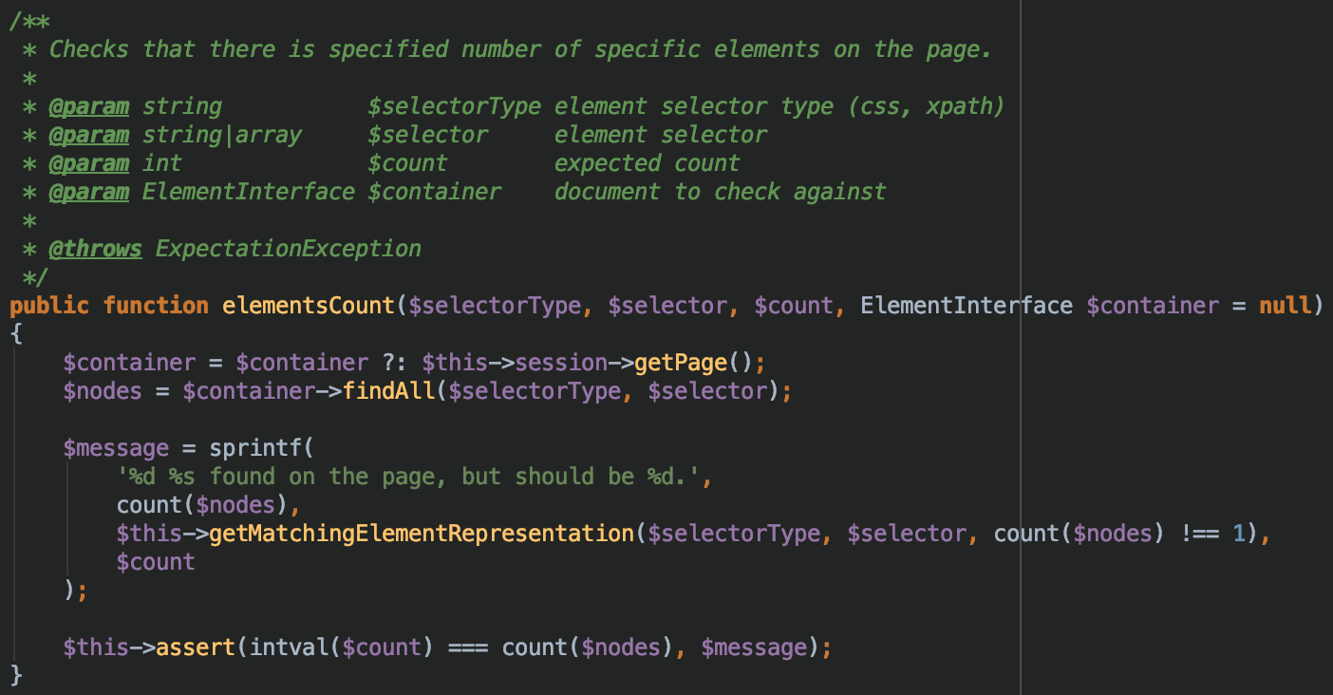
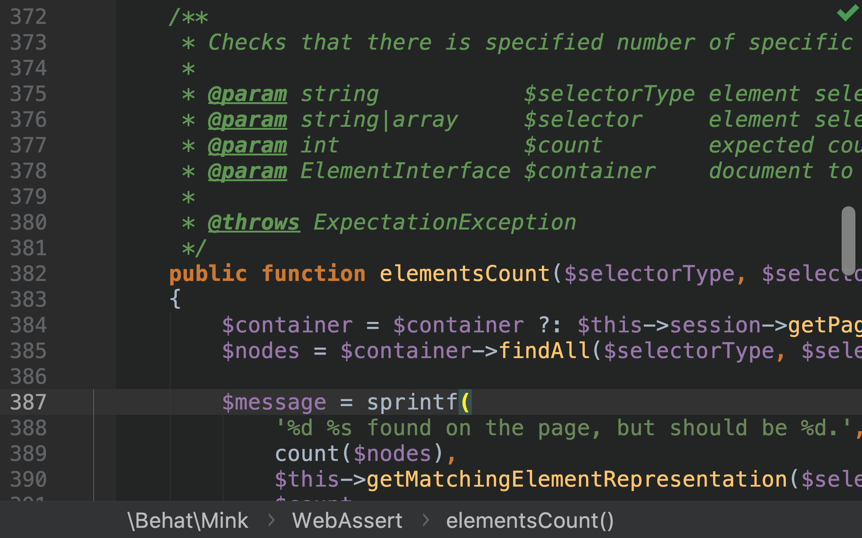
present
Size your code/demo so that it’s big enough to see in the back of the room. This means zooming your browser to at least 175%.
For code demos, use PHPStorm’s presentation mode. Remember the keyboard shortcuts! (Full screen mode is command-ctrl-f. Presentation mode is command-shift-p for me.)
Have your code windows already open before you start. Don’t go looking for something during your talk.
Here’s the same code, standard zoom on top, in Presentation mode on the bottom.
Notes:
----- Meeting Notes (2/22/18 20:14) -----
Go to the info file in the module already up - midcamp_migrate_pdf.info.yml

Slide 21
present
If you have live demos:
Practice them.
Time them.
If they run too slow, you can record them and play them back at increased speed during your talk.
Know what to do if something breaks.
Image used from https://camius.com/camius_best_suvreillance_ip_cameras_with_advanced_centralized_video_management_software/start-live-demo/ without permission.
Notes:
----- Meeting Notes (2/22/18 20:14) -----
Go to the info file in the module already up - midcamp_migrate_pdf.info.yml

Slide 22
Don’t self-sabotage

Slide 23
Don’t self sabotage
You can do this.
“But I’m not an expert!”
“But everyone else is so knowledgeable!”
“But what if people think my solution is bad?”
“But what if this isn’t the best way to solve the problem?”
Your presentation could help someone else solve a problem they’re having.
Image used from https://www.quickanddirtytips.com/health-fitness/mental-health/6-reasons-why-we-self-sabotage without permission.
Notes:
----- Meeting Notes (2/22/18 20:14) -----
Go to the info file in the module already up - midcamp_migrate_pdf.info.yml

Slide 24
Do it!
Just do it!
You can do it!
Notes:
----- Meeting Notes (2/22/18 20:14) -----
Go to the info file in the module already up - midcamp_migrate_pdf.info.yml

Slide 25
Submitting your talk

Slide 26
Submitting your talk
Check the submission dates!
Follow the rules for submission.
Make your description enticing.
Don’t be afraid to submit more than one topic.
Don’t get discouraged if your talk wasn’t accepted.
Notes:
----- Meeting Notes (2/22/18 20:14) -----
Go to the info file in the module already up - midcamp_migrate_pdf.info.yml

Slide 27
What to expect

Slide 28
Before you present
The staff is here to help you!
Get to your room before the talk before you finishes.
Connect to the recording devices.
Go to the bathroom before you start!
Have a bottle of water handy. Avoid soda, heavy dairy, and alcohol.
Use lip balm before you begin.
Watch your time.
Notes:
----- Meeting Notes (2/22/18 20:14) -----
Go to the info file in the module already up - midcamp_migrate_pdf.info.yml

Slide 29
Presenting
Put your computer into Do Not Disturb mode.
Close all of your apps and browser tabs that don’t relate to your presentation. (Slack, email, etc.)
Make sure your battery is fully charged.
Speak clearly.
Enunciate.
Slow down!
Notes:
----- Meeting Notes (2/22/18 20:14) -----
Go to the info file in the module already up - midcamp_migrate_pdf.info.yml

Slide 30
Q&A
Repeat questions from the audience so the mic can pick them up.
Don’t be afraid to say you don’t know.
Be open to suggestions or corrections.
Notes:
----- Meeting Notes (2/22/18 20:14) -----
Go to the info file in the module already up - midcamp_migrate_pdf.info.yml

Slide 31
Jonathan “Jack” Franks
Jonathan.franks@breaktech.com
https://www.breaktech.com
Feedback:
http://mid.camp/267

